Slide 1


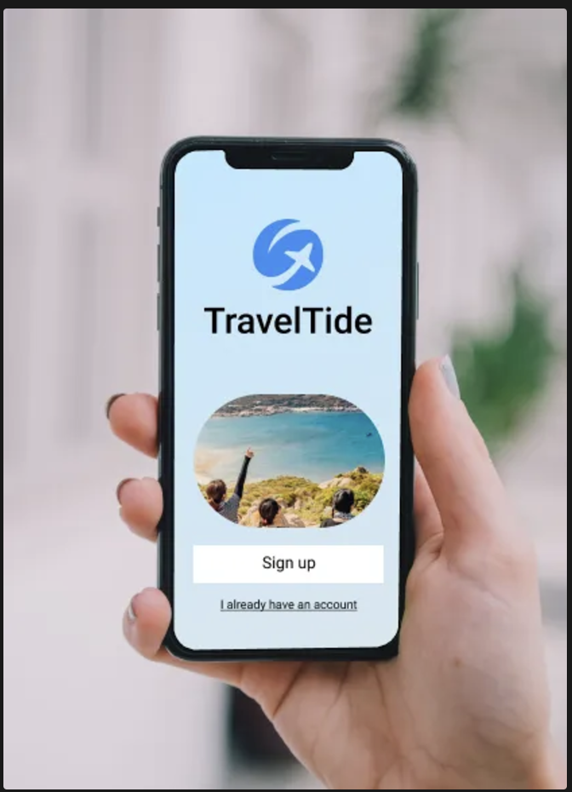
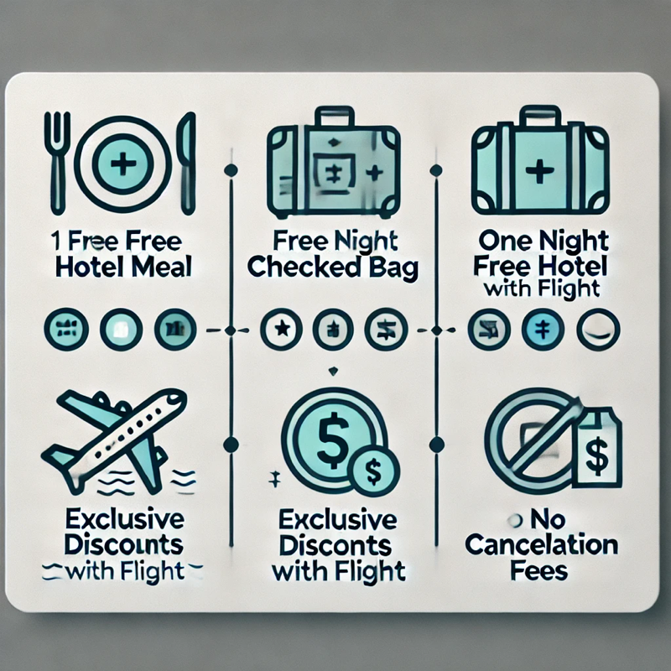

TRAVELTIDE PROJECT
Customer Segmentation
Dr. Otieno J. A.; Kyprianou L.
Masterschool Data Analytics 28th of November 2024 Masterschool - Berlin

Slide 2
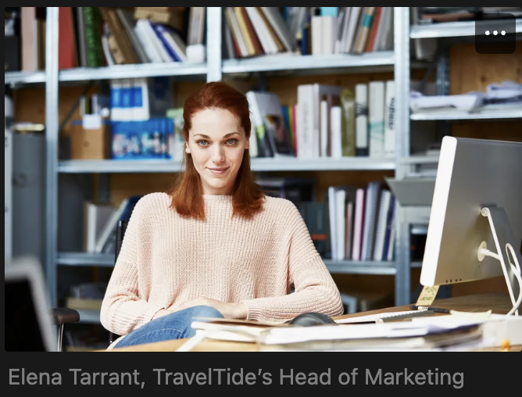
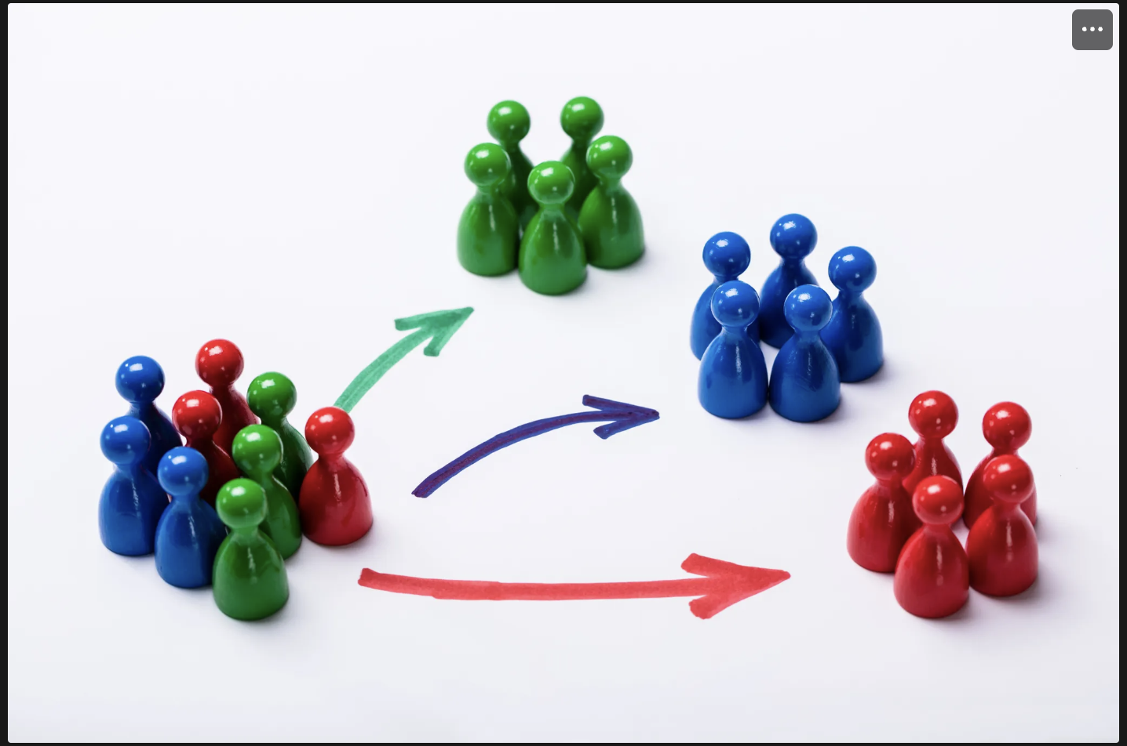
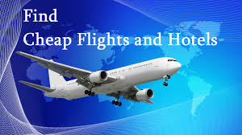
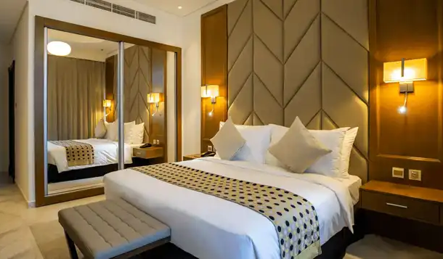

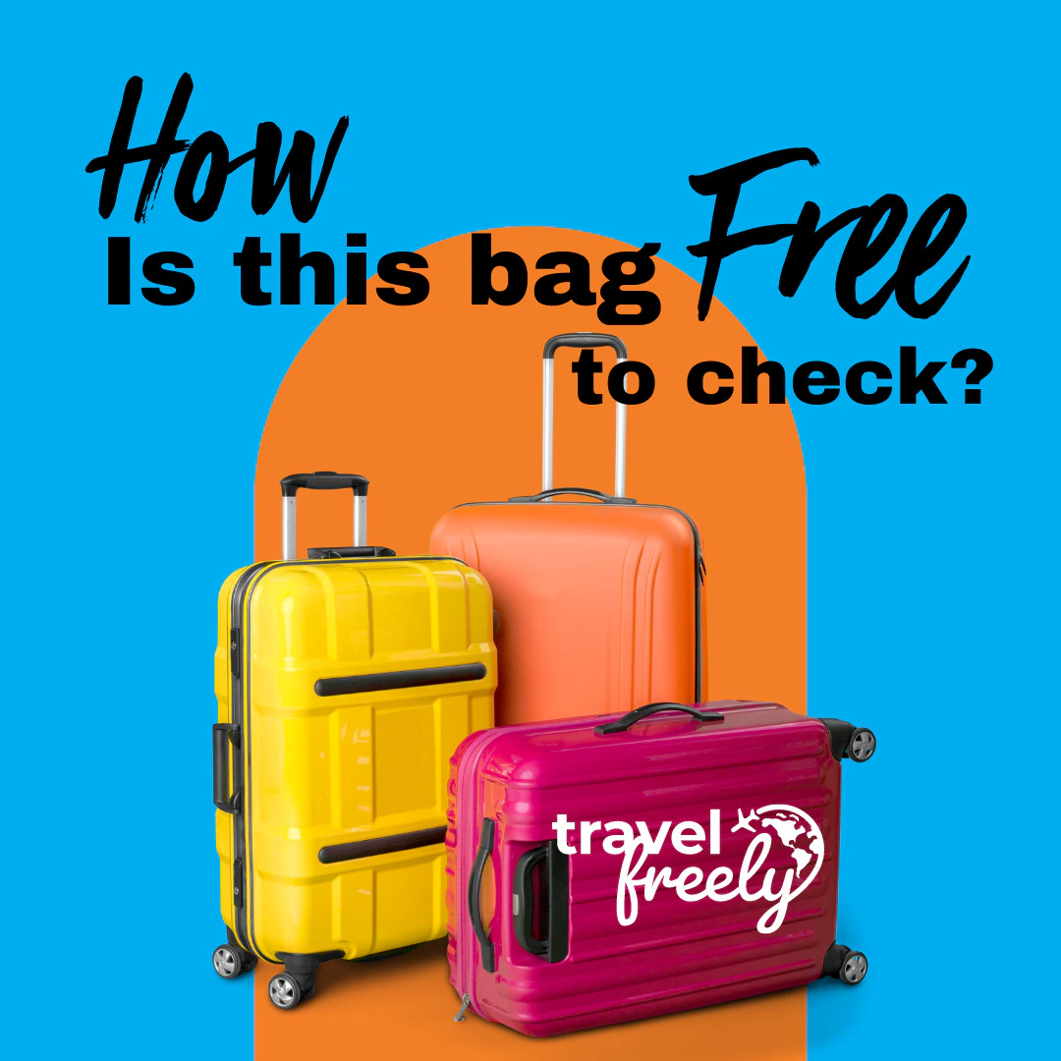
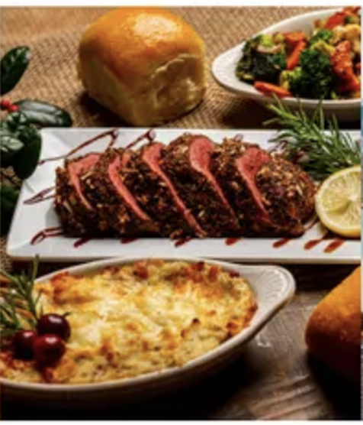
Introduction
What is Segmentation?
TravelTide-Founded 2021: Fast-growing e-booking platform with unmatched travel inventory and search tech.
Retention Issue: Low customer loyalty despite strong technology.
Solution: Personalized rewards program using segmentation to tailor perks.
Leadership: Elena Tarrant, customer retention expert, spearheads the initiative.
Perks: Free meals, Free checked bags, no cancellation fees, Exclusive discounts, and 1 night free hotel with flight

Slide 3
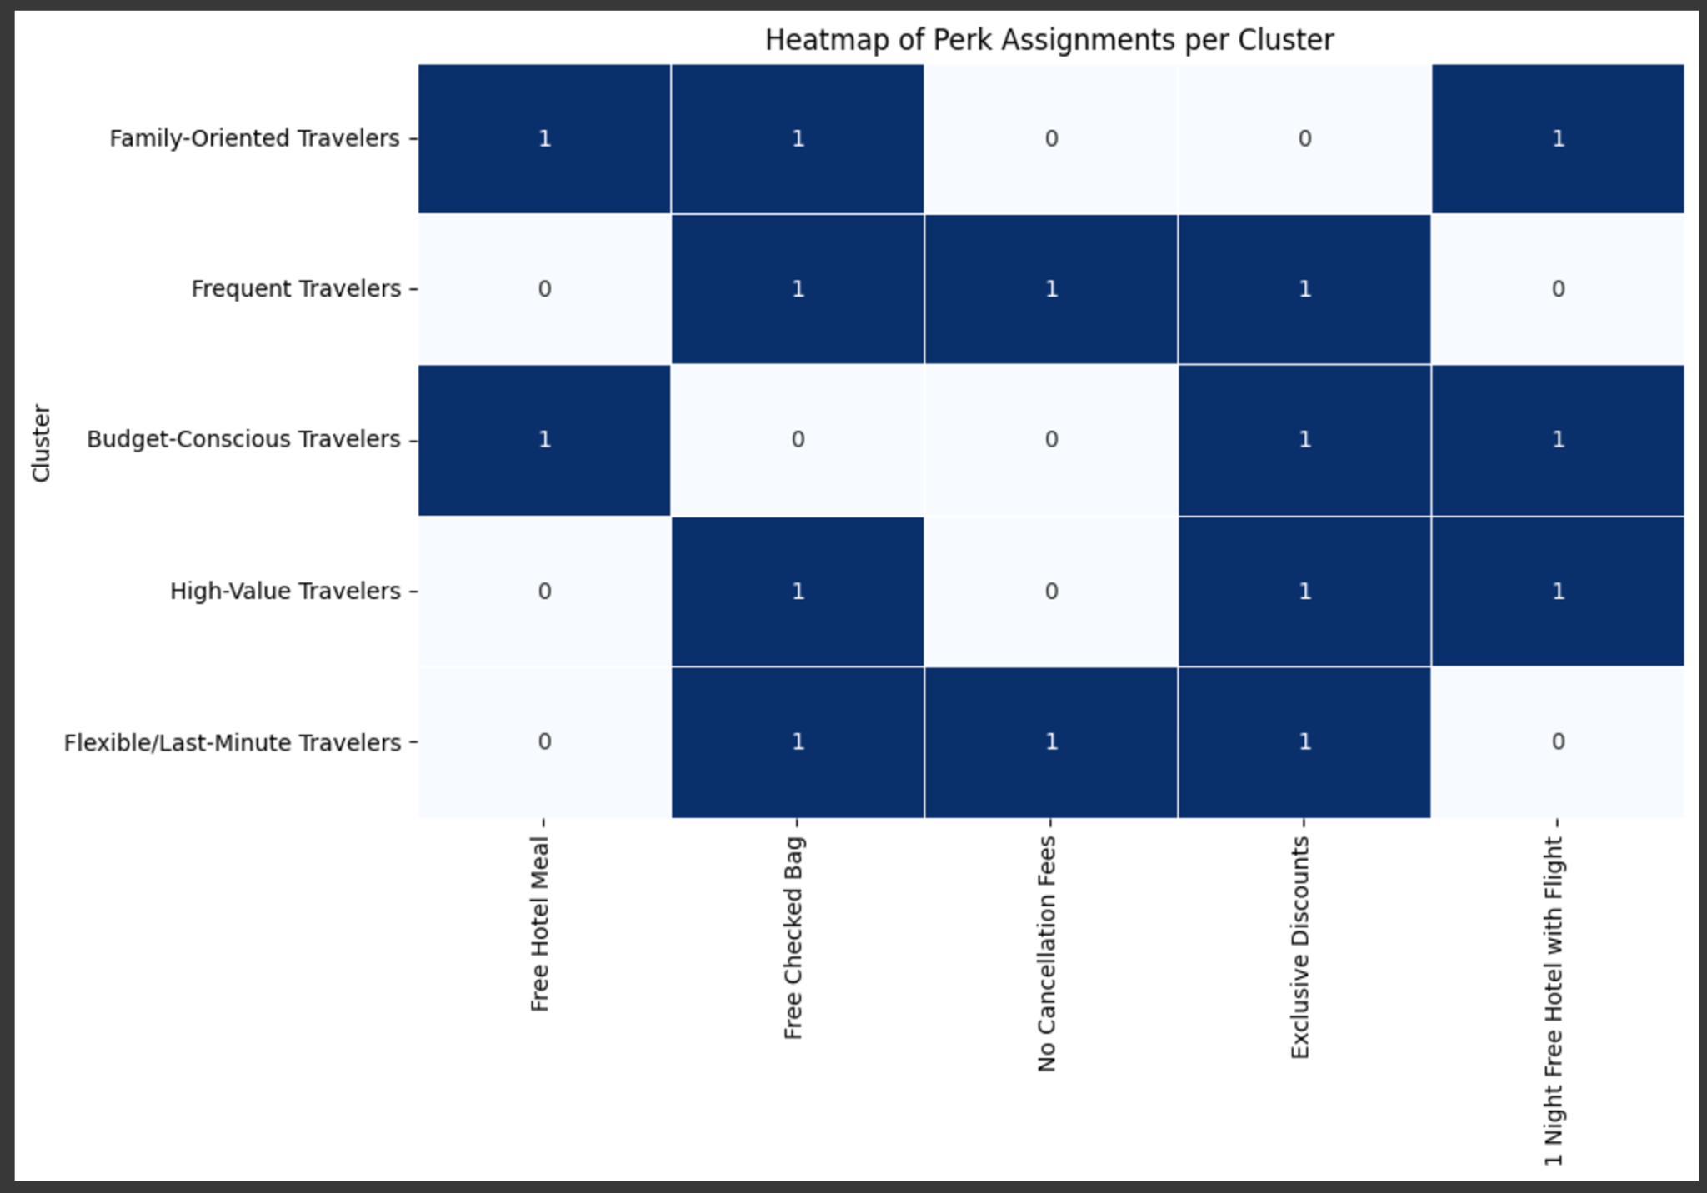
Executive Summary
Identified five distinct customer clusters with unique behaviors and needs.
Used data cleaning,feature engineering, and KMeans clustering for analysis.
Tailored perks like free meals and no cancellation fees to match preferences.
Executive Summary
Improved loyalty and engagement through targeted, data-driven rewards.
Segmented customers to enable personalized rewards and boost retention.
Strengthened competitive edge by enhancing customer experience and satisfaction.

Slide 4
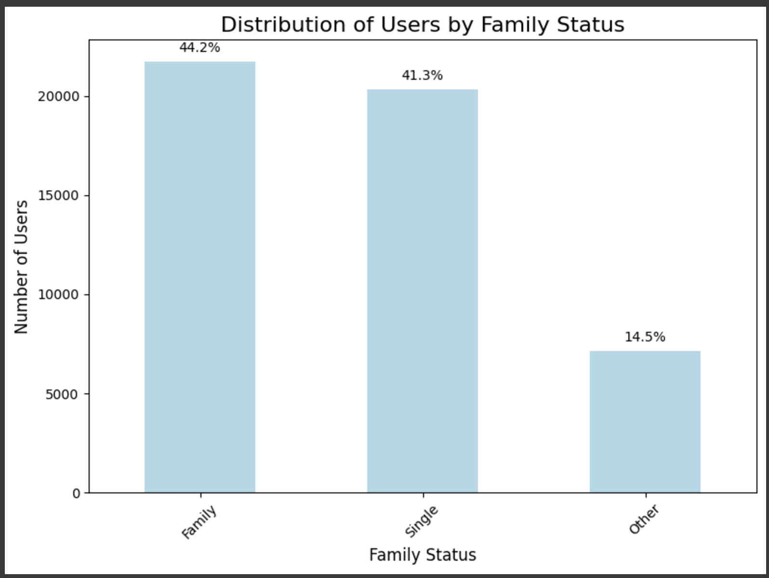
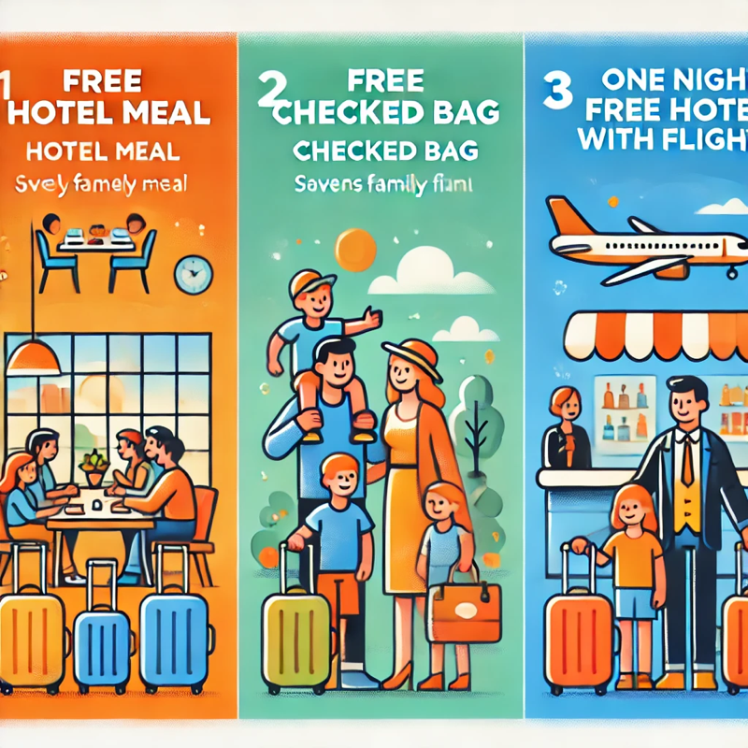
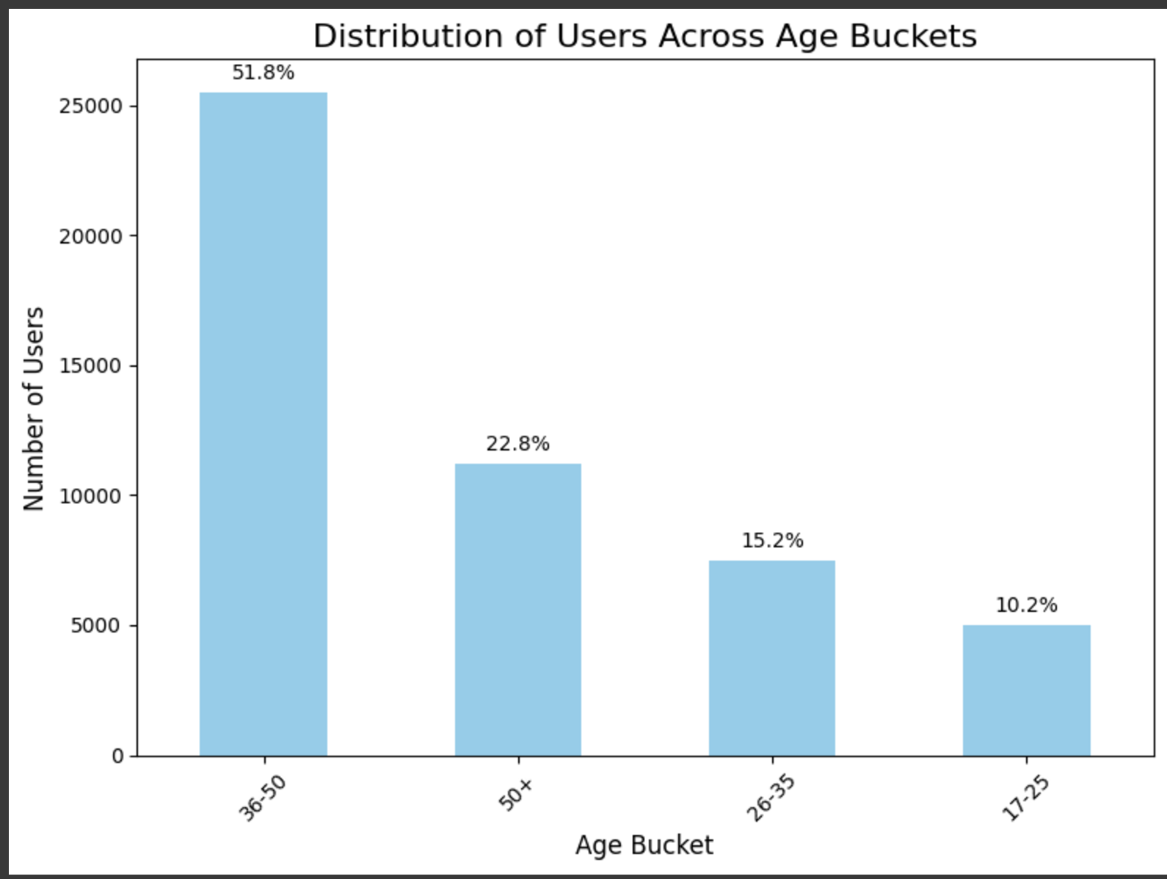
Family oriented travellers
Profile: Ages (26-45), Convenience & Cost-Saving Perks
1. Married with children 2. Multiple rooms, longer stays (Targets 44.2% of Travellers)
Perks Assigned:
Free Hotel Meal: Saves on family meals.
Free Checked Bag: Families often travel with extra luggage.
1 Night Free Hotel with Flight: Ideal for longer stays

Slide 5
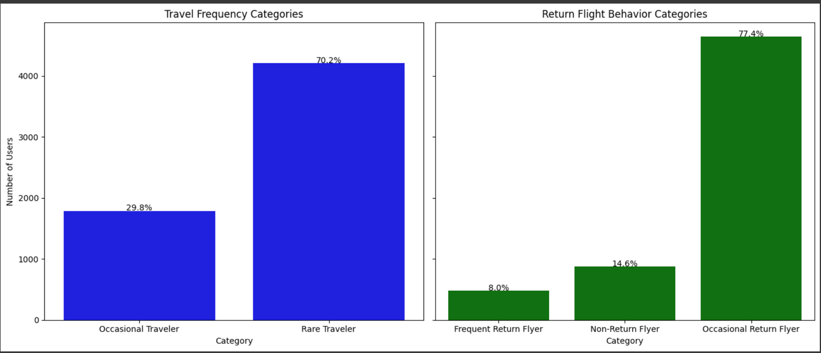
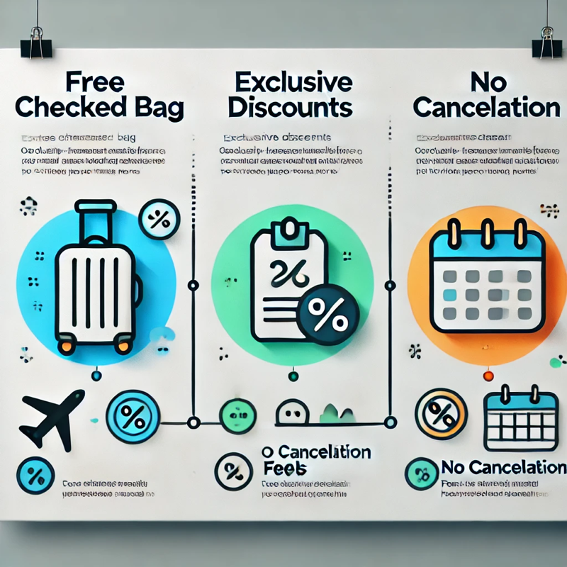
Frequent Travellers
Frequent flight/hotel bookings
High activity level
Flexible with plans
Perks Assigned:
Free Checked Bag: Frequent travelers need convenience.
Exclusive Discounts: Loyal travelers appreciate deals.
No Cancellation Fees: Flexibility is crucial for this group

Slide 6
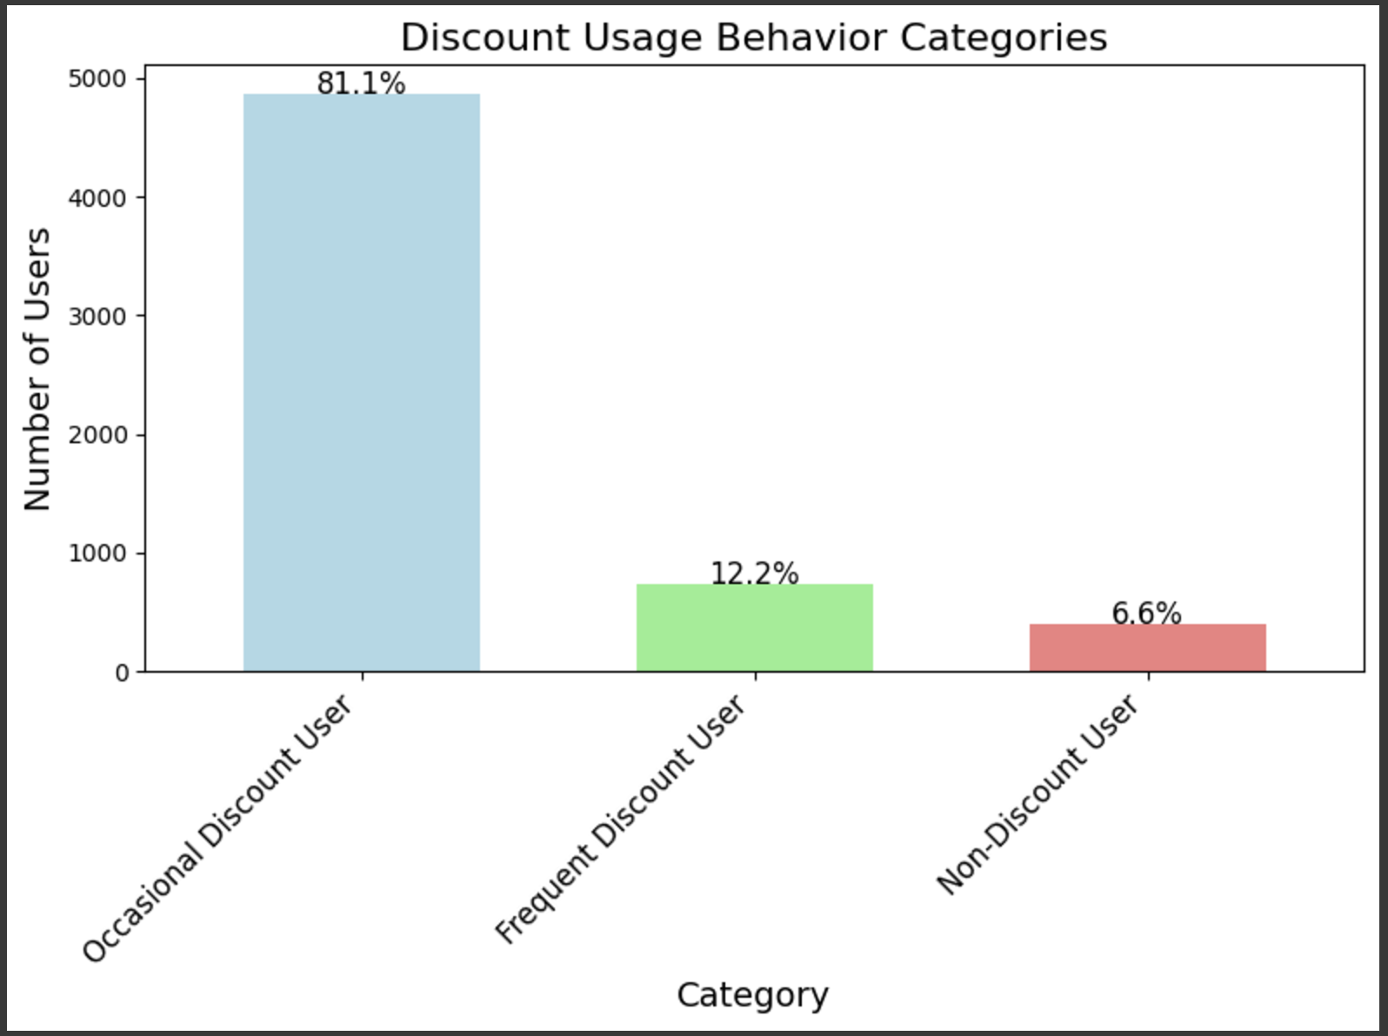
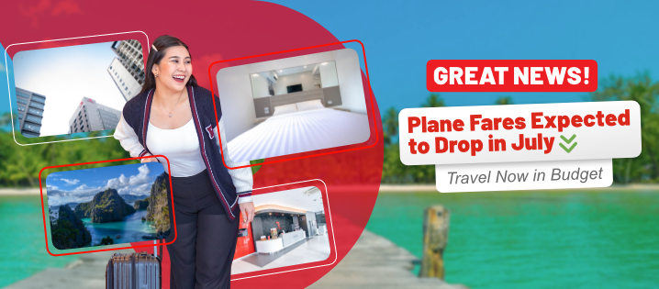
Budget-Conscious Travellers
Profile: They seek deals and savings
Sensitive to discounts
Budget-friendly flights and hotels
Lower spend per trip
Target the 81% occasional discount users
Perks assigned:
Free Hotel Meal: Ideal for reducing overall costs, making it appealing to this group.
Exclusive Discounts: They look for the best value and appreciate discount offers.
1 Night Free Hotel with Flight: Helps them save on accommodation costs, an added incentive.

Slide 7

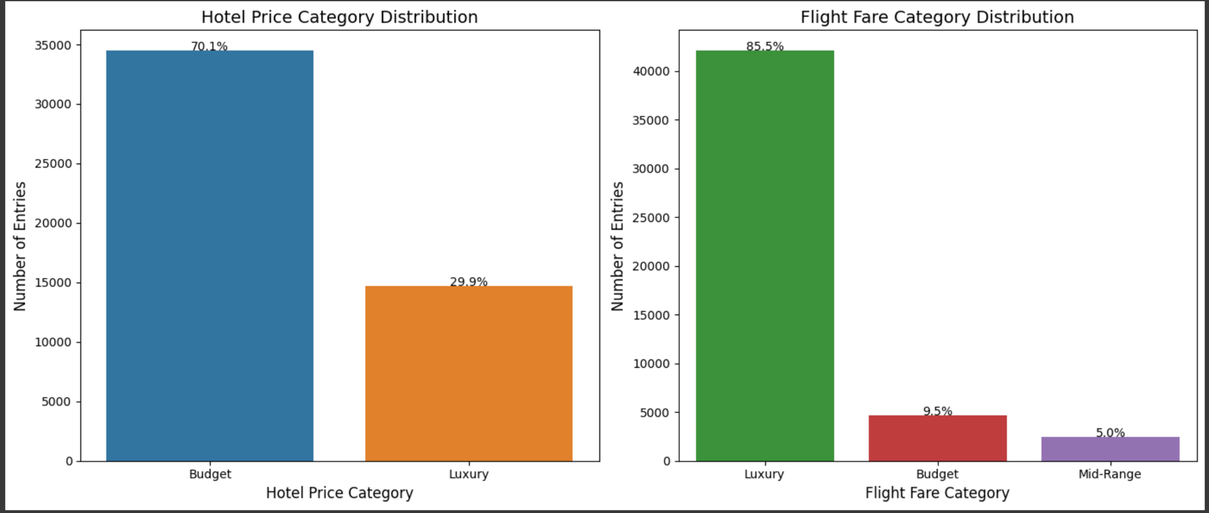
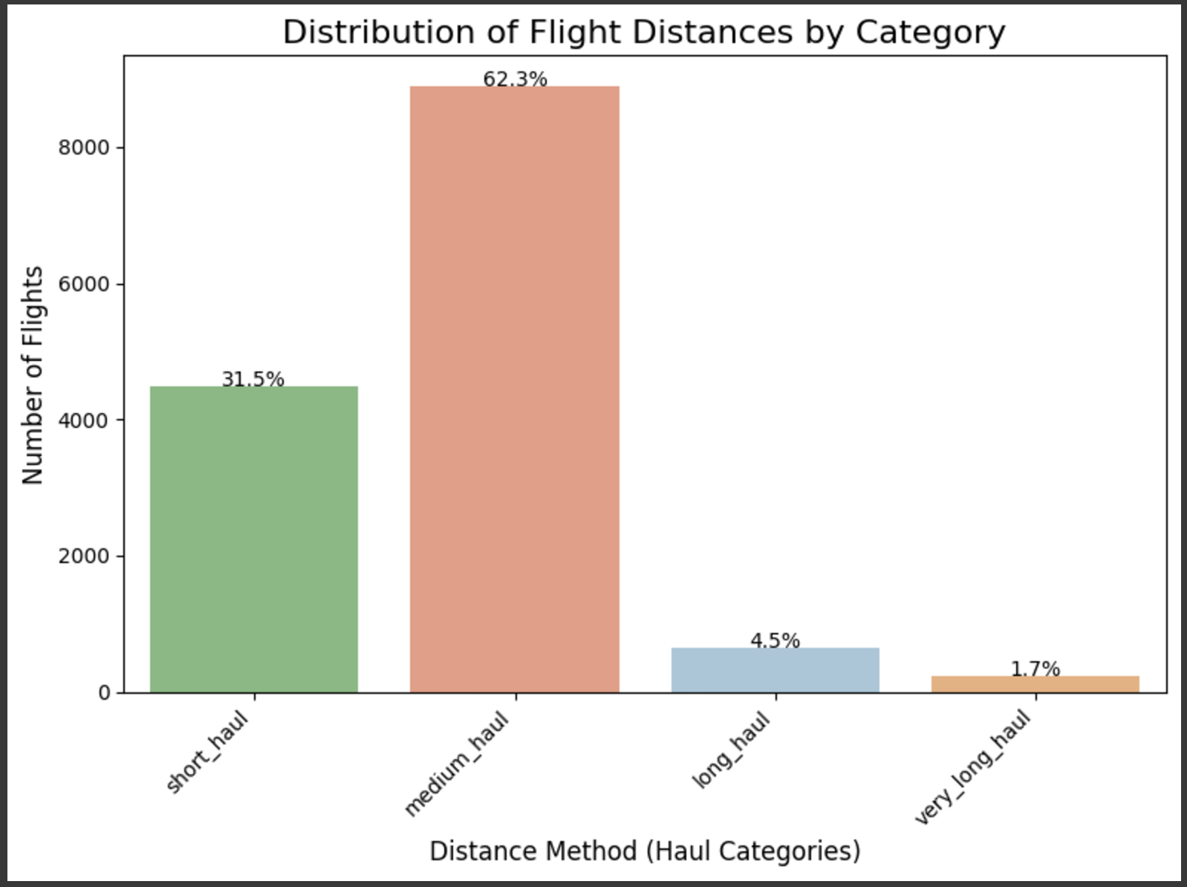
High-Value/High-Spending Travellers
Profile: Premium travelers seeking luxury experiences and high-value perks (85.5%)
Key Features:
Premium service bookings
Luxury preferences (e.g., first-class flights(85.5%), however only 29.9% booked luxury hotels)
Longer stays - Target the Medium_haul of 62.3% to stay longer
Perks assigned:
Free Checked Bag: Adds comfort for high-end travelers.
Exclusive Discounts: Luxury clients value exclusivity and personalized offers.
1 Night Free Hotel with Flight: Adds significant value, especially for longer stays.

Slide 8

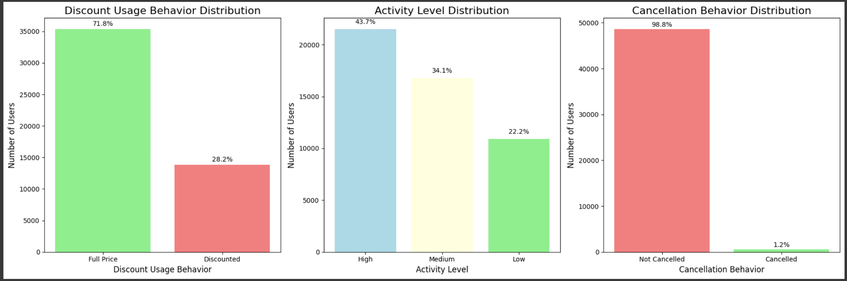
Flexible/Last- Minute Travellers
Profile: Flexible travelers tend to book last-minute with high cancellation rates.
Key Features:
Frequently cancel or modify bookings
Highly flexible with travel plans
Likely to book at the last minute
Perks assigned:
No Cancellation Fees: This perk is crucial for last-minute bookings.
Exclusive Discounts: Provides an incentive for booking at the last minute.
Customer Behavior on Discounts and Cancellations
Limited Discount Usage: Only 28.2% of customers utilized discounts.
Rare Flight Cancellations: 1.2% of customers cancelled their flights.

Slide 9
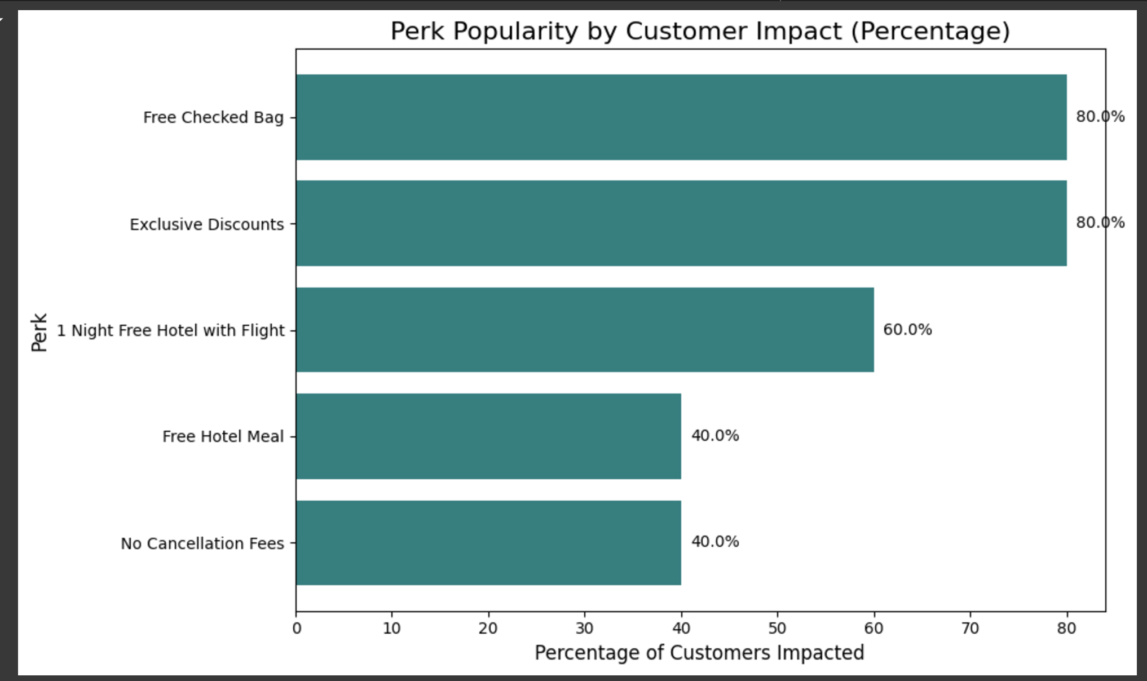
Which Perks Rank Highest Across Customer Clusters?
1.Exclusive Discounts: Assigned to four clusters.
1.Free Checked Bag: Assigned to four clusters.
2.1 Night Free Hotel with Flight: Assigned to three clusters.
3.No Cancellation Fees: Assigned to two clusters.
3.Free Hotel Meal: Assigned to two clusters.
Business Focus:
Prioritize Exclusive Discounts & Free Checked Bags: Key perks driving savings and convenience.
Wide Appeal: Enhance value and engagement across diverse traveler profiles.
# Which is the most popular Perk across many clusters
Ranked Perks:
1. Exclusive Discounts - Assigned to all five clusters.
2. Free Checked Bag - Assigned to all five clusters.
3. 1 Night Free Hotel with Flight - Assigned to four clusters.
4. No Cancellation Fees - Assigned to two clusters.
5. Free Hotel Meal - Assigned to two clusters.
Business Focus:
TravelTide should focus on launching Exclusive Discounts and Free Checked Bag, as these are universally appealing across all segments. They cater to savings and convenience, which are critical motivators for a wide range of travelers.

Slide 10

Conclusion and Recommendation
Tailored Rewards: Boost satisfaction, retention, and revenue with personalized perks.
Targeted Loyalty: Drive engagement by focusing on high-value customer segments.
Sustained Success: Ensure long-term growth through strategic monitoring and refinements.
Launch Rewards Program: Implement personalized rewards for targeted segments.
A/B Testing: Compare effectiveness of perks and delivery methods across segments.
Test Hypotheses: Validate assumptions using program performance data.
Monitor Response: Collect feedback and track key metrics like engagement and retention.
Refine Strategy: Continuously adjust perks and segmentation based on insights.

